Slide 1
LDME Graph Summarization
By Jemish Variya and Raj Patel

Slide 2
Introduction
The most popular family of summarization methods is the group - based approach.
Group - based Approach
Merging nodes of the original graph into supernodes of the summary graph, encoding original edges into superedges [exactly same approach upon which DPGS is structured].
We are focusing on one group - based summarization technique while including correction set.
Current state of the art has several steps in its computation that are serious bottlenecks in terms of running time and scalability.

Slide 3
Correction Set - Based Graph Summarization

Slide 4
Current State of the art …
The current state of the art correction set based graph summarization algorithm is SWeG.
SWeG is faster and elegant than all of its competitors, yields better compression than other methods, and can also run in a distributed setting.
SWeG improves upon the original correction set based framework by
Adding a dividing step that divides the nodes into smaller groups prior to merging (for parallelizability and efficiency)
Introducing an approximation metric for finding nodes to merge.
Despite the impressive performance of SWeG compared to other algorithms, there are several steps in the algorithm which bottleneck its performance.

Slide 5
Current State of the art …
Bottlenecks
Merging algorithm is quadratic in the size of groups, so its running time suffers due to the dividing step not creating small enough groups of nodes.
Finding best merge candidates supernodes.
Encoding algorithm, since it scales quadratically based on the number of supernodes, making it perform poorly for larger graphs.
So how to overcome this bottlenecks of SWeG without losing its effectiveness and efficiency…

Slide 6
Locality Sensitive Hashing Divide Merge Encode [LDME]
Makes optimizations in each step of SWeG.
Introduces weighted locality sensitive hashing to reduce the amount of computation during the merge phase.
Efficient method of computing the best merges.
Faster and more scalable encoding algorithm.

Slide 7
Reconstruction Scheme
Procedure to reconstruct the original graph from the summarized graph.
Many existing summarization model uses the Uniform Reconstruction scheme to reconstruct the graph.
But real world graph database has highly degree skewed nodes.
That creates large differences between original graphs and reconstructed graphs in terms of degrees of nodes and other properties of graph.

Slide 8
DPGS
Assigns superedges proportional to node degrees in original graph.
Uses Minimum Description Length (MDL) to minimize the cost of summary Graph and Reconstruction Error.
It uses Locality Sensitive Hashing (LSH) to group candidate nodes and it merges nodes greedily within the groups.
More efficient yet effective than uniform reconstruction scheme in real world highly skewed graphs.

Slide 9
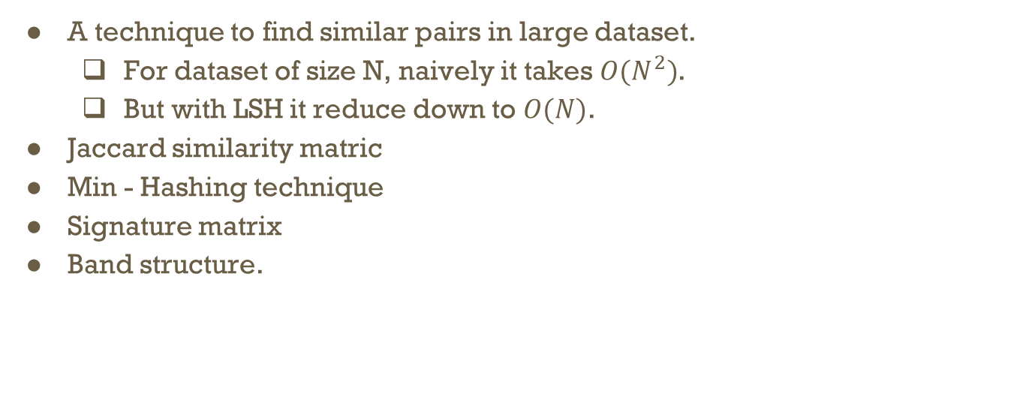
What is LSH?
A technique to find similar pairs in large dataset.
For dataset of size N, naively it takes $O(N^{2})$.
But with LSH it reduce down to $O(N)$.
Jaccard similarity matric
Min - Hashing technique
Signature matrix
Band structure.

Slide 10
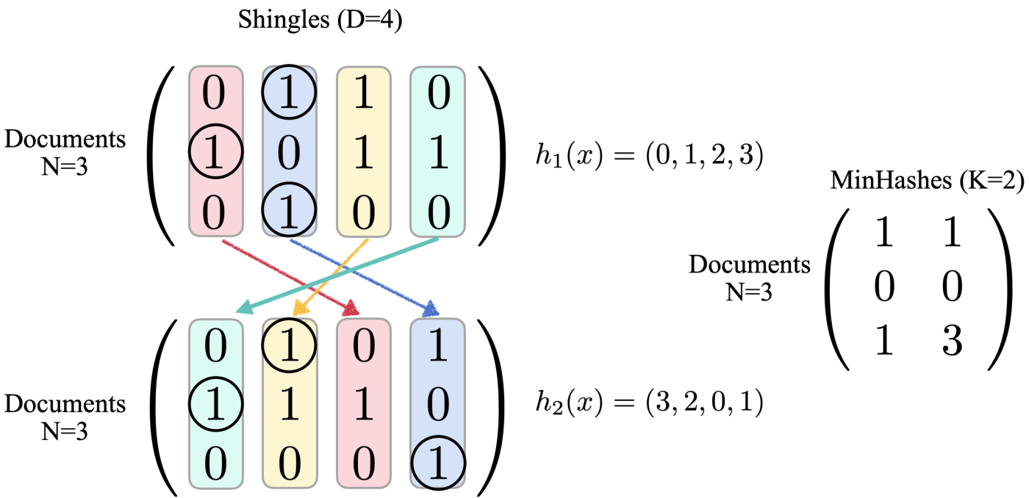

Slide 11
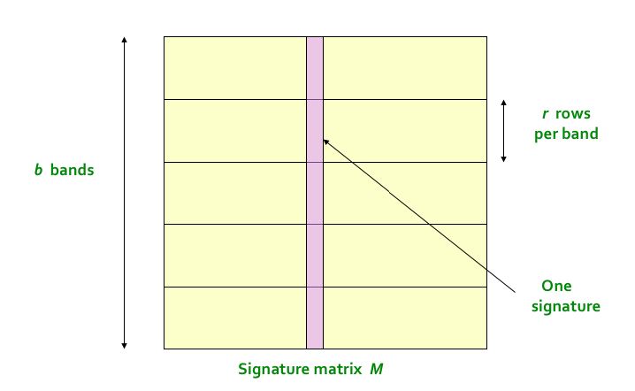

Slide 12
DPGS Summarization
It uses MDL to create summary Graph with minimum error.
Mathematical formulation of Objective Function is given as:
L(M,D) = L(M) + L(D|M)
where, L(M) = Description Length of summary Graph
L(D|M) = Description Length of Errors.

Slide 13
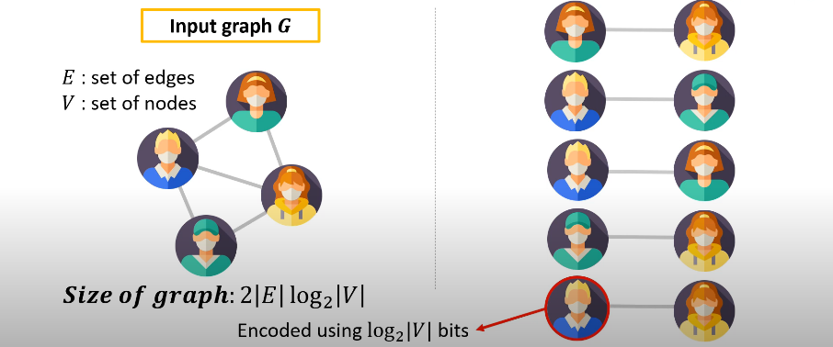
Size of input graph G

Slide 14
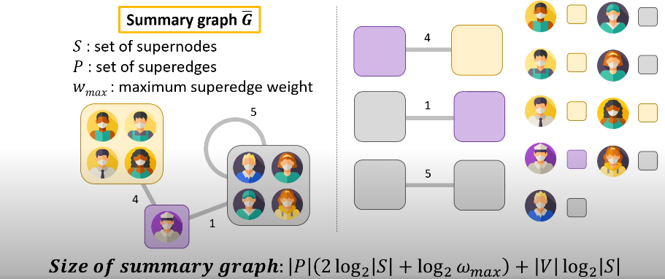

Size of Summary graph $\overline{G}$

Slide 15
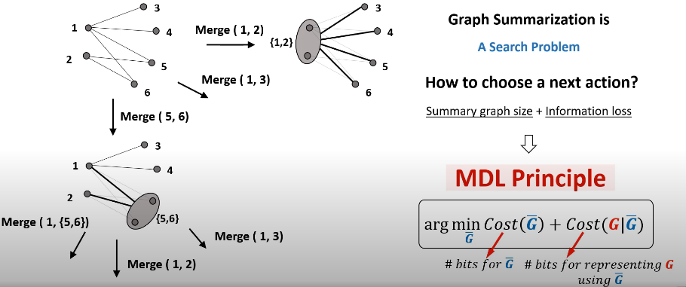
MDL Principle

Slide 16
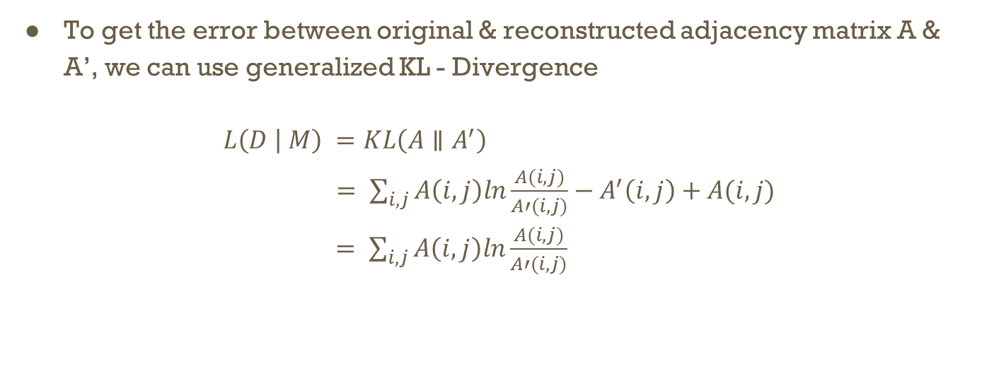
DPGS Summarization
To get the error between original & reconstructed adjacency matrix A & A’, we can use generalized KL - Divergence
$L\left(D | M\right) =KL\left(A∥A^{′}\right)$
$= \sum_{i,j}{A\left(i,j\right)ln\frac{A(i,j)}{A′(i,j)}−A^{′}\left(i,j\right)+A(i,j)}$
$= \sum_{i,j}{A\left(i,j\right)ln\frac{A(i,j)}{A′(i,j)}}$

Slide 17
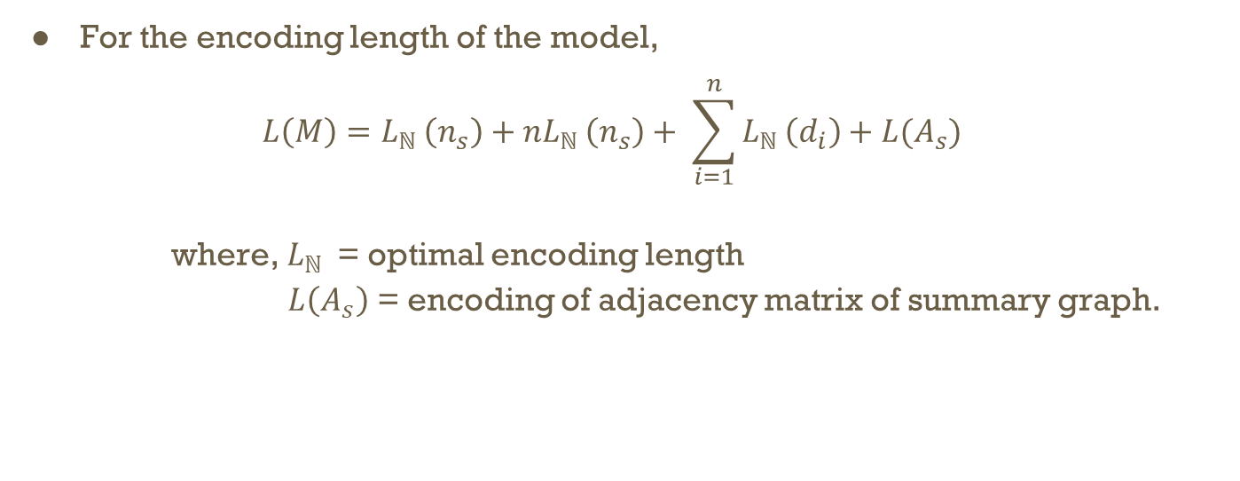
DPGS Summarization
For the encoding length of the model,
$$L\left(M\right)=L_{ℕ }\left(n_{s}\right)+nL_{ℕ }\left(n_{s}\right)+ \sum_{i=1}^{n}{L_{ℕ }\left(d_{i}\right)+L(A_{s})}$$
where, $L_{ℕ }$ = optimal encoding length
$L\left(A_{s}\right)$ = encoding of adjacency matrix of summary graph.

Slide 18
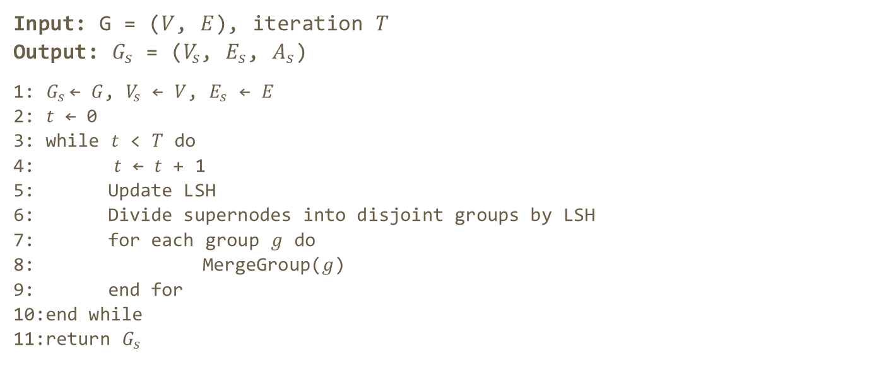
DPGS Algorithm
Input: G = ($V$, $E$), iteration $T$
Output: $G_{s}$ = ($V_{s}$, $E_{s}$, $A_{s}$)
1: $G_{s}$← $G$, $V_{s}$ ← $V$, $E_{s}$ ← $E$
2: $t$ ← 0
3: while $t$ < $T$ do
4: $t$ ← $t$ + 1
5: Update LSH
6: Divide supernodes into disjoint groups by LSH
7: for each group $g$ do
8: MergeGroup($g$)
9: end for
10:end while
11:return $G_{s}$

Slide 19
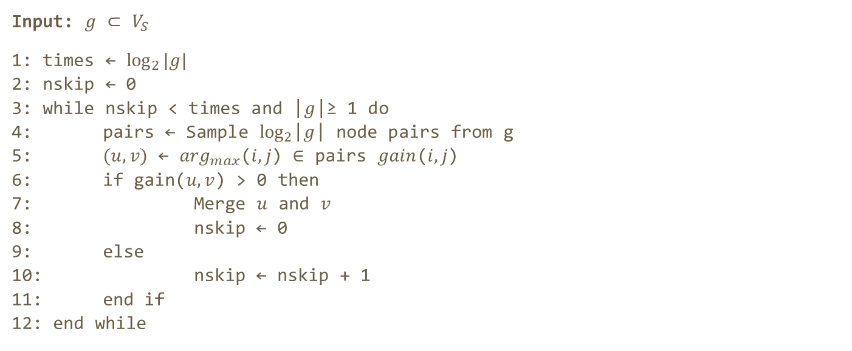
Merge Group Algorithm
Input: $g$ ⊂ $V_{S}$
1: times ← ${log⁡}_{2}|g|$
2: nskip ← 0
3: while nskip < times and |$g$|≥ 1 do
4: pairs ← Sample ${log⁡}_{2}$|$g$| node pairs from g
5: $(u,v)$ ← $\arg_{max}$($i,j$) ∈ pairs $gain$($i,j$)
6: if gain($u,v$) > 0 then
7: Merge $u$ and $v$
8: nskip ← 0
9: else
10: nskip ← nskip + 1
11: end if
12: end while

Slide 20
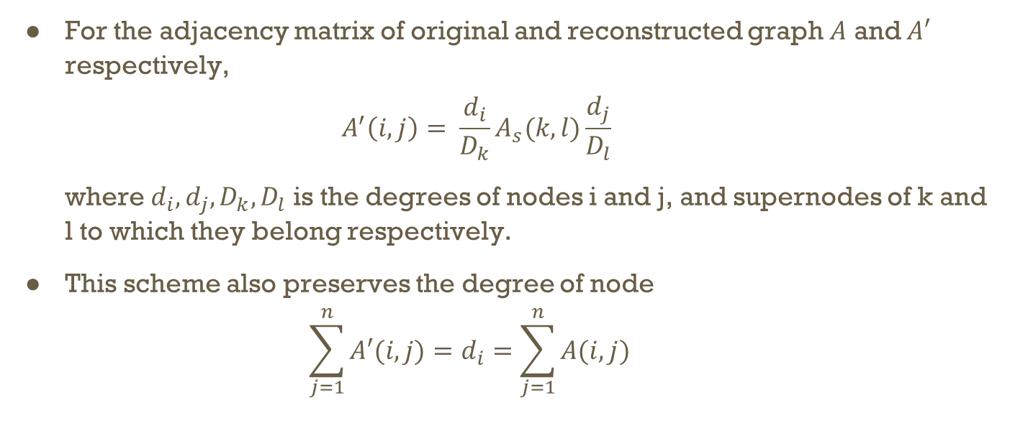
Configuration Based Reconstruction Scheme (CR Scheme)
For the adjacency matrix of original and reconstructed graph $A$ and $A′$ respectively,
$$A^{′}\left(i, j\right)= \frac{d_{i}}{D_{k}}A_{s}(k, l)\frac{d_{j}}{D_{l}}$$
where $d_{i},d_{j},D_{k},D_{l}$ is the degrees of nodes i and j, and supernodes of k and l to which they belong respectively.
This scheme also preserves the degree of node
$$\sum_{j=1}^{n}{A′(i, j)}=d_{i}=\sum_{j=1}^{n}{A(i,j)}$$

Slide 21
Advantages of DPGS
The time complexity of the algorithm is O(T∙|E|).
This algorithm works efficiently in both Uniform and Highly Degree Skewed graphs.
This algorithm can reconstruct the original graph more efficiently and accurately than uniform reconstruction scheme, especially in Degree skewed graphs.
This algorithm can help to train a graph neural network efficiently, while preserving high accuracy in node classification task.

Slide 22
Conclusion
DPGS algorithm is effective and efficient summarization algorithm which bounds perturbation of graph spectrum.
It gives better summary than several state-of-art methods.
It can be used to upgrade summarization models to improve their reconstruction accuracy.
It can be used in training of graph neural networks with less resources without compromising the performance.

Slide 23
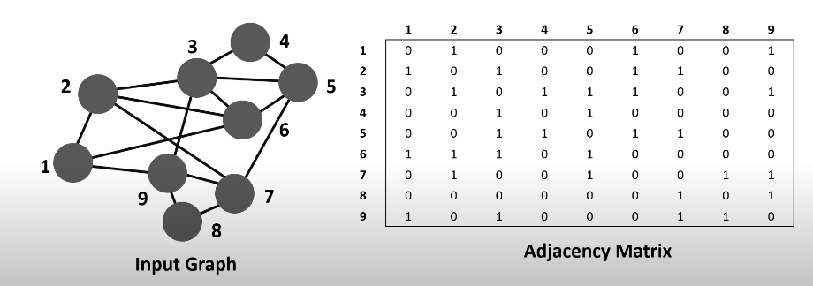
Example

Slide 24
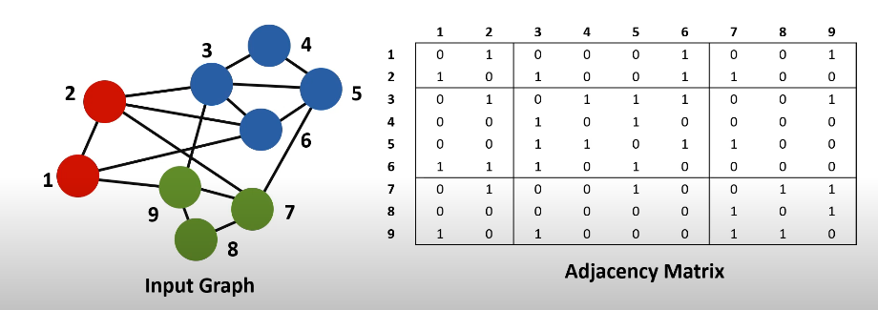
Example

Slide 25
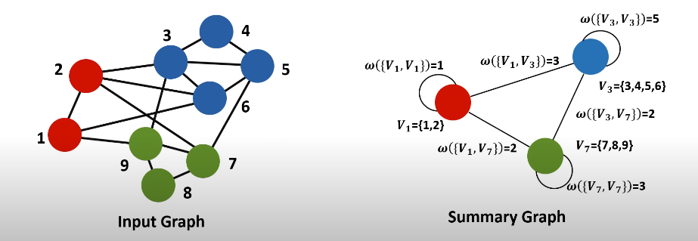
Example

Slide 26
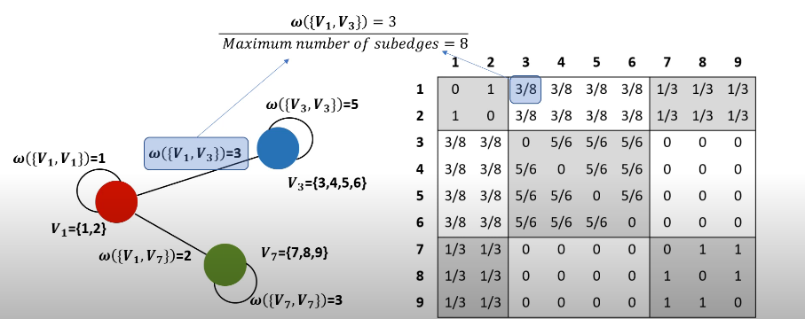
Example

Slide 27
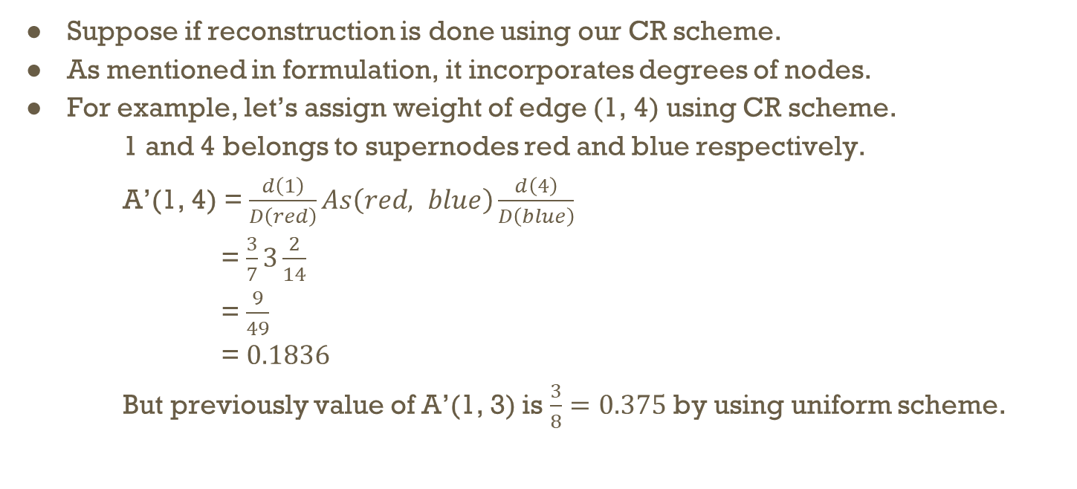
Example
Suppose if reconstruction is done using our CR scheme.
As mentioned in formulation, it incorporates degrees of nodes.
For example, let’s assign weight of edge (1, 4) using CR scheme.
1 and 4 belongs to supernodes red and blue respectively.
A’(1, 4) = $\frac{d\left(1\right)}{D\left(red\right)}As\left(red, blue\right)\frac{d\left(4\right)}{D\left(blue\right)}$
= $\frac{3}{7}3\frac{2}{14}$
= $\frac{9}{49}$
= $0.1836$
But previously value of A’(1, 3) is $\frac{3}{8}=0.375$ by using uniform scheme.

Slide 28
Experimental Analysis
Comparison of reconstruction schemes
Degree distribution with parameter α = 3.0, 3.5, 4.0. Improvement is very high for more skewed graphs(high α value).
Effectiveness
Achieves 28% less description length
Compatibility
Summarization models upgraded with CR scheme achieves more accurate results.
Training GNNs on Summary Graphs
Without sacrificing performance GNNs, we can reduce running time and memory by summarizing the graphs.
Scalability
DPGS algorithm scales linearly with the number of edges.

Slide 29
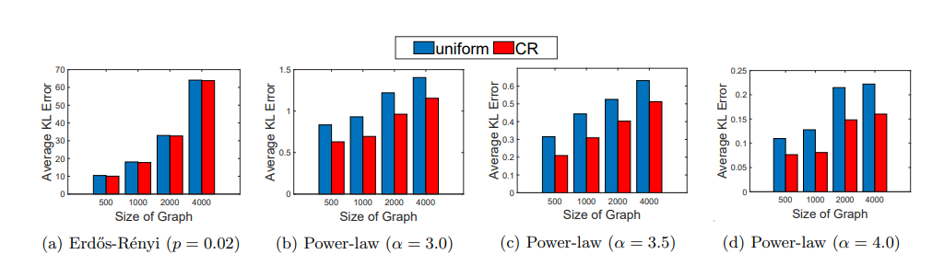
Experimental Results [1]

Slide 30
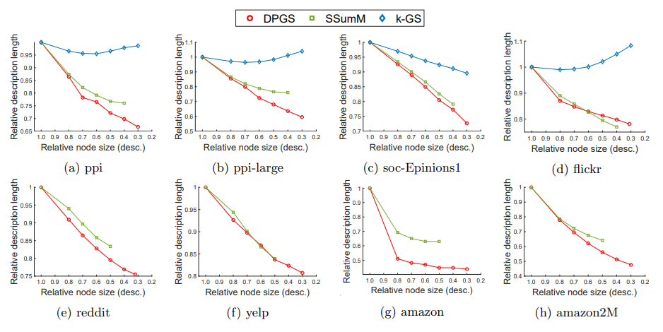
Experimental Results [2]

Slide 31
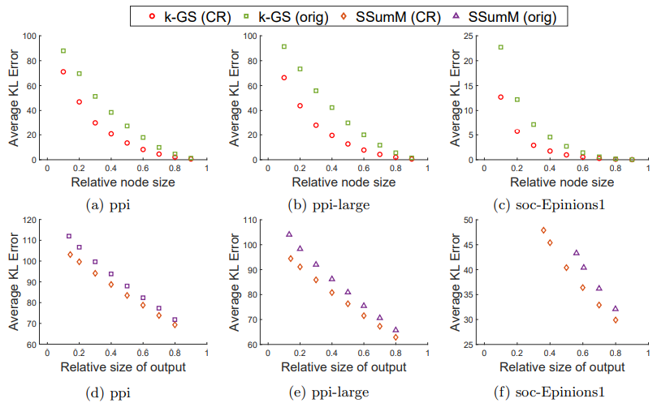
Experimental Results [3]

Slide 32
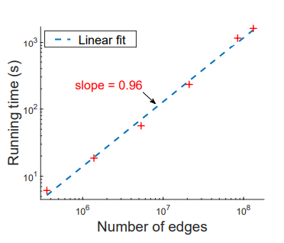
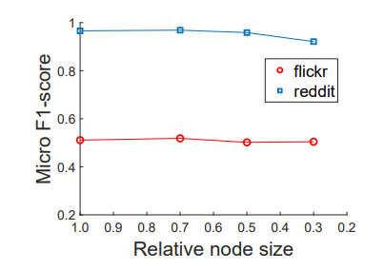
Experimental Results[4] & [5]

